Slide 1
Decipher the following coded message
1st word
2nd word
5 14 3 18 25 16 20 9 15 14
1 14 4
3rd word
4th word
4 1 20 1 12 15 19 19
12 5 19 19 15 14

Slide 2
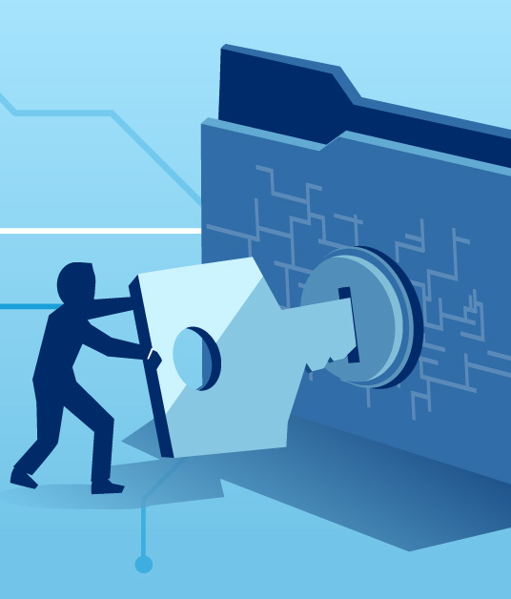
Computer Security
Encryption and Data Backup

Slide 3

Objectives
At the end of the lesson students should be able to
Define the term encryption
State the purpose of encryption
Describe the two types of encryption keys
Describe what is a digital signature
Explain in detail the concepts of digital certificate
Describe data protection measures such as data backup and disk mirroring

Slide 4

Encryption
Process of converting readable data into unreadable characters so that only authorized parties can read or access the data
The unencrypted, readable text is called-plaintext. The encrypted (scrambled) data is called cipher text.
It uses complex algorithms to scramble the data being sent.
The security effectiveness is determined by the strength of the algorithm and the length of the key.

Slide 5

Encryption makes information unreadable to an unauthorized party therefore the information remains private and confidential, whether being transmitted or stored on a system.
Unauthorized parties will see nothing but an unorganized assembly of bytes.
Encryption technology can provide assurance of data integrity as some algorithms offer protection against forgery and tampering.
The ability of the technology to protect the information requires that the encryption and decryption keys be properly managed by authorized parties.

Slide 6

Activity 1
In groups research on the following concepts
Asymmetric key
Symmetric Key Encryption
Outlines the
Process
Advantages and disadvantages
Give examples of how each is used
Digital Signature
Digital Certificate
Outlines
What it is
Purpose of DS/DC
what information is contained in each document
Present your findings by creating a PPT of not more than 5 slides

Slide 7

Presentation Encryption keys

Slide 8

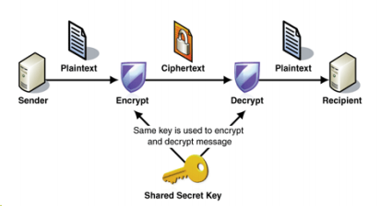
Two types of Encryption
Private key also called Symmetric Key Encryption
Both the originator and the recipient use the same secret key to encrypt and decrypt the data.
One key is needed to encrypt a message and same key is needed to decrypt a message.
It is obviously important that the sender and receiver have the same encryption and decryption key.
Key distribution is a security problem The sender has to supply the key to the recipient which can be intercepted by a hacker

Slide 9
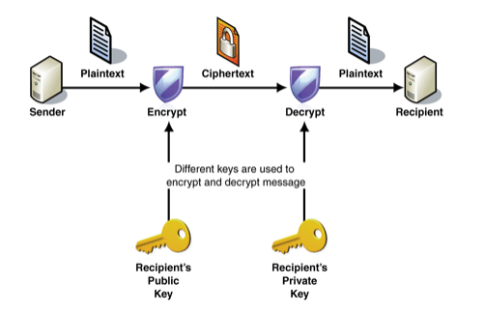
Public key Encryption, also called Asymmetric key
Uses two encryption keys: a public key and a private key.
Public key encryption software generates both the private key and the public key.
A message encrypted with a public key can be decrypted only with the corresponding private key, and vice versa.
The public key is made known to message originators and recipients but the private key is only known by the computer user.

Slide 10

Review

Slide 11
Presentation Digital Signature and Digital Certificate

Slide 12
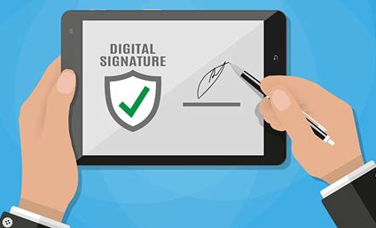
Digital Signatures
A digital signature is a specific type of electronic signature that requires the signer to authenticate their identity using a certificate-based digital ID.
The digital certificate is generally issued by an independent Certificate Authority (CA), which verifies the identity of the signer before issuing the certificate.
It is an encrypted code that a person, web site, or organization attaches to an electronic message to verify the identity of the message sender.
A digital signature is used to verify that the content of a message has not changed.

Slide 13
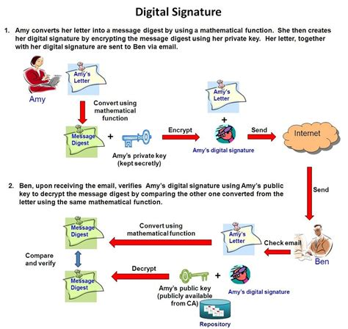
Digital Signatures
The code usually consists of the user’s name and a hash of all or part of the message.
Receivers of the message decrypt the digital signature by generating a new hash of the received message and compares it with one in the digital signature to ensure they match. Digital signatures often are used to ensure that an impostor is not participating in an Internet transaction. That is, digital signatures help to prevent e-mail forgery.

Slide 14
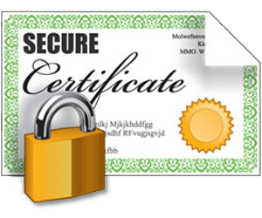
Digital Certificate is an electronic "password" that allows a person, organizaion to exchange data securely over the Internet using the public key infrastructure (PKI). Digital Certificate is also known as a public key certificate or identity certificate.

Slide 15
Digital Certificate Characteristics
Identification / Authentication: The person who we are communicating with are who they are
Confidentiality: The information within the message or transaction is kept confidential. It may only be read and understood by the intended sender and receiver
Integrity: The information within the message or transaction is not tampered accidentally or deliberately with en-route without all parties involved being aware of the tampering
Non-Repudiation: The sender cannot deny sending the message or transaction, and the receiver cannot deny receiving it
Access Control: Access to the protected information is only realized by the intended person or entity

Slide 16
Contents of a Digital Certificate
Subject Name - "subject" refers to the site represented by the cert.
Information about the certificate issuer/certificate authority (CA) - The CA is the body that issued and signed the certificate.
Serial number - this is the serial number assigned by the issuer to this certificate. Each issuer must make sure each certificate it issues has a unique serial number.
Validity period - certificates aren't meant to last forever. The validity period defines the period over which the certificate can still be deemed trustworthy.
Signature - This is the digital signature of the entire digital certificate, generated using the certificate issuer's private key
Signature algorithm - The cryptographic signature algorithm used to generate the digital signature (e.g. SHA-1 with RSA Encryption)
Public key information - Information about the subject's public key. This includes:
the algorithm (e.g. Elliptic Curve Public Key),
the key size (e.g. 256 bits),
the key usage (e.g. can encrypt, verify, derive), and
the public key itself

Slide 17

Review

Slide 18

Data Backup Methods

Slide 19
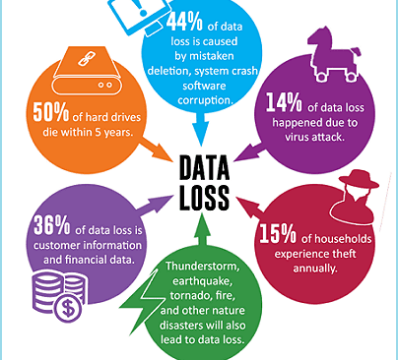
Data Loss
In addition to problems arising from malicious activity there are a variety of reasons for accidental loss of data.
A disk or tape gets corrupted
A disk or tape is destroyed
The system crashes
The file is erased or overwritten by mistake
The location of the file is forgotten.

Slide 20

What is Data Backup?
Data backup is a process of duplicating active data to allow retrieval of the duplicate set after a data loss event
The purpose of backing up data is to ensure that if anything happens to the original file, the backup copy can be used to restore the file without loss of data and within a reasonable time-frame.

Slide 21
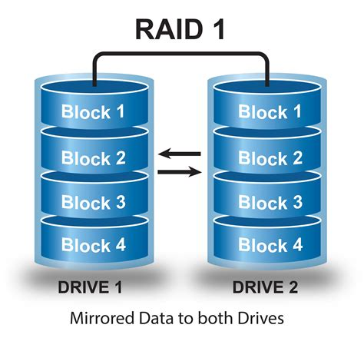
Disk Mirroring
Backup technique in which data is written simultaneously to two or more hard disks.
In the event of a disk failure, the computer automatically switches access to the next disk, without loss of data or interrupting data processing. This is known as fault tolerance
In some configurations, backup disks are maintained at a remote site (mirror site) for additional safety.

Slide 22

Disk Mirroring
Disk mirroring (also known as RAID-1 (Random Array of Independent Disks)) is the practice of duplicating data in separate volumes on two hard disks to make storage more fault-tolerant.
Mirroring provides data protection in the case of disk failure, because data is constantly updated to both disks.
Fault-tolerant technology is a capability of a computer system, electronic system or network to deliver uninterrupted service, despite one or more of its components failing.

Slide 23
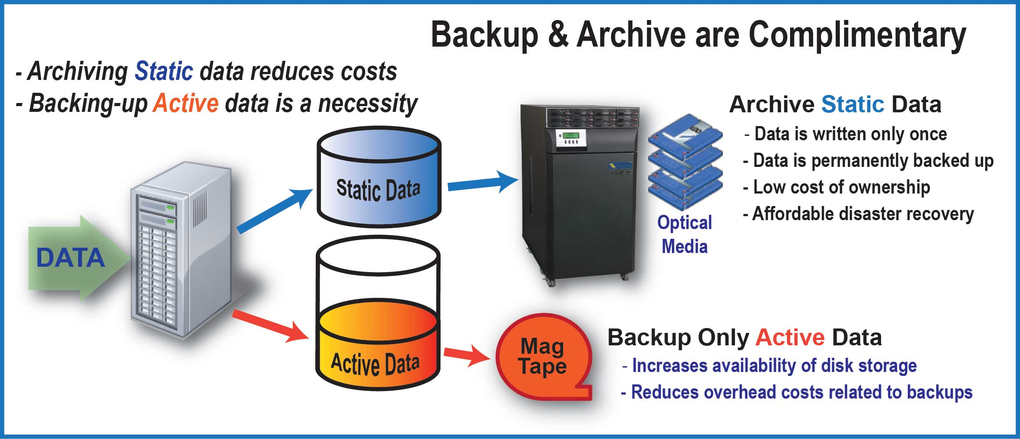
What is Data Archiving?
Data archiving is:
The process of retaining data for long term storage. The data might not be in use, however, it can be brought into use and can be stored for future purposes
intended to protect older information that is not needed for everyday operations but may have to be accessed occasionally.
a way of reducing primary storage and the related costs, rather than acting as a data recovery tool.
data that is not active but is too important to delete

Slide 24

Activity
Complete the tasks set out on the worksheet

